Slide 1
Analyzing Factors Influencing Income Levels
By: Shawn Dornan, Jaden Der, Poonam Phagura, James Ding

Slide 2
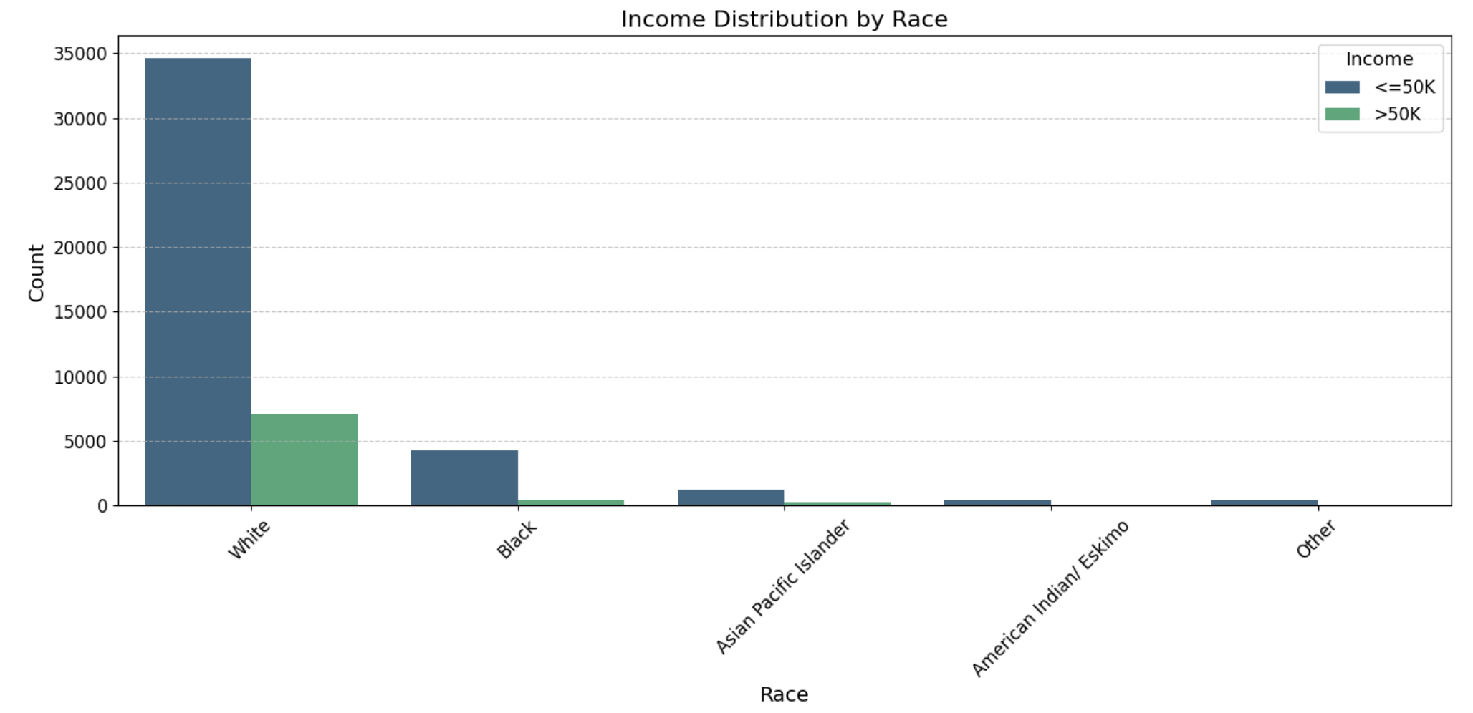
Introduction

Slide 3
Agenda
Introduction
Dataset Overview
Data preprocessing
EDA’s
Feature Selection and Dimensionality Reduction
Modeling
Assumptions
Guiding Questions
Conclusions
Future work

Slide 4
Dataset Overview
We are using the Adult Income Dataset from the UCI Machine Learning Repository.
Dataset URL: https://archive.ics.uci.edu/dataset/2/adult
Variables:
Age, Workclass, fnlwgt, Education, education-num, marital-status, Occupation, Relationship, Race, Gender Capital-gain, Capital-loss, Hours-per-week, Native-country,Salary: >50K,<=50K

Slide 5
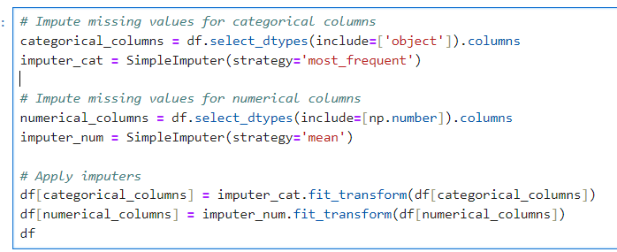
Data Preprocessing
The data includes missing values '?'. The code is used to handle the missing values by replace '?' with NaN and encoding variables.
Impute missing values with
‘Most_Frequent’ -Categorical Columns
'Mean' – Numerical Columns

Slide 6
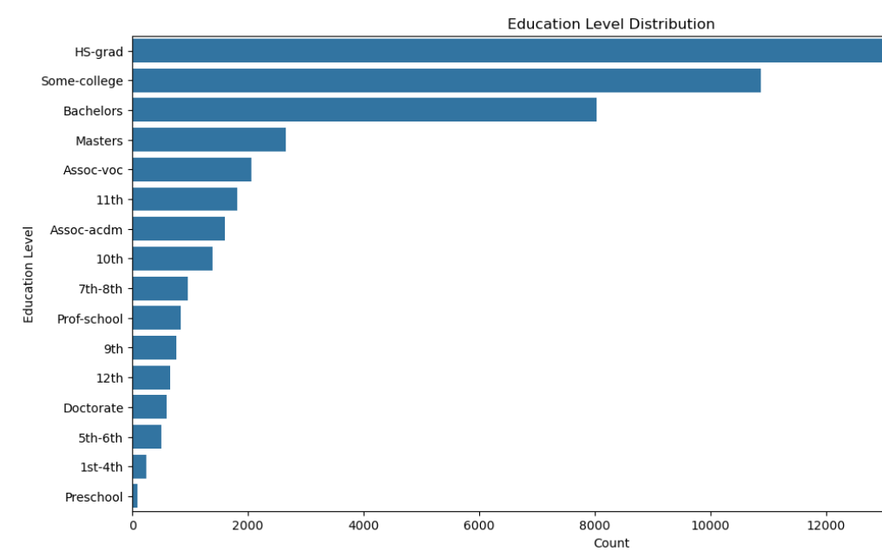
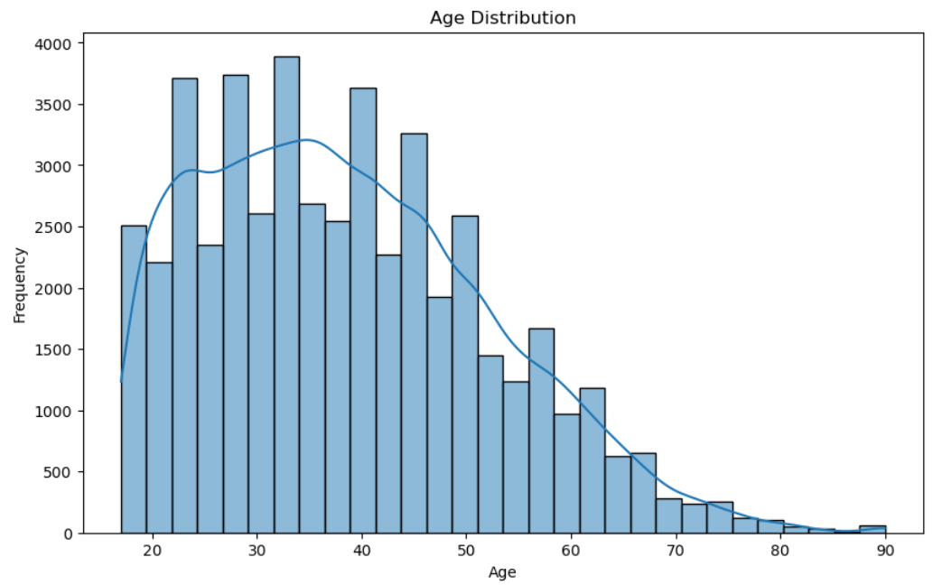
EDA’s
Education Level Distribution
The bar chart illustrates the distribution of different education levels within the dataset.
Age Distribution​
The histogram displays the distribution of ages within the dataset.​
Notes:
The most common education level is "HS-grad" (High School graduate), followed by "Some-college" and "Bachelors".Age Distribution
The age distribution shows a right-skewed pattern, with a peak around the 30-40 age range outline of the age distribution, highlighting the central tendency and spread of the data.
Insights
Demographic Trends: The data indicates a majority of individuals in the dataset are high school graduates or have some college education, primarily falling within the working-age group of 30-40 years.

Slide 7
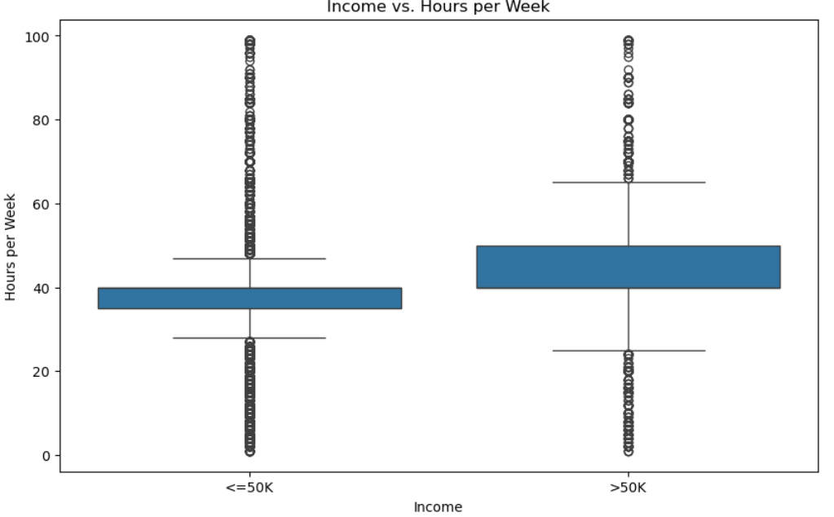
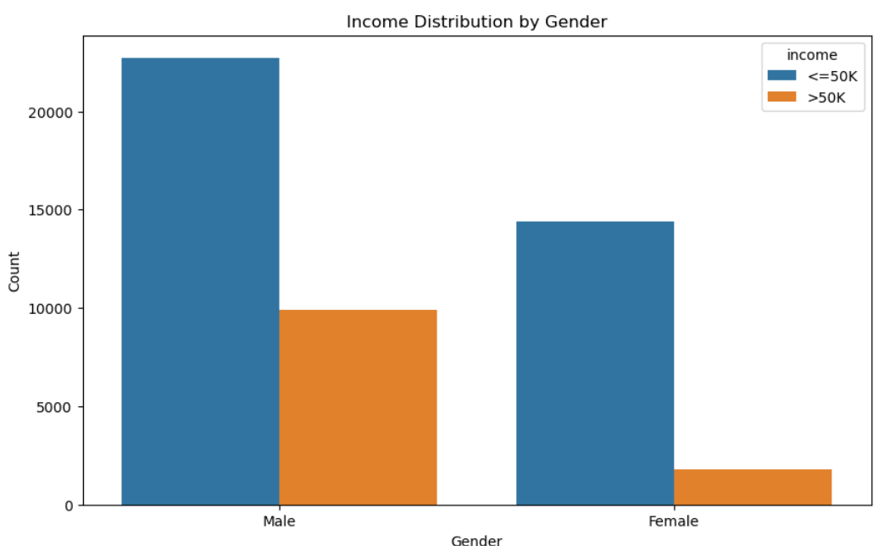
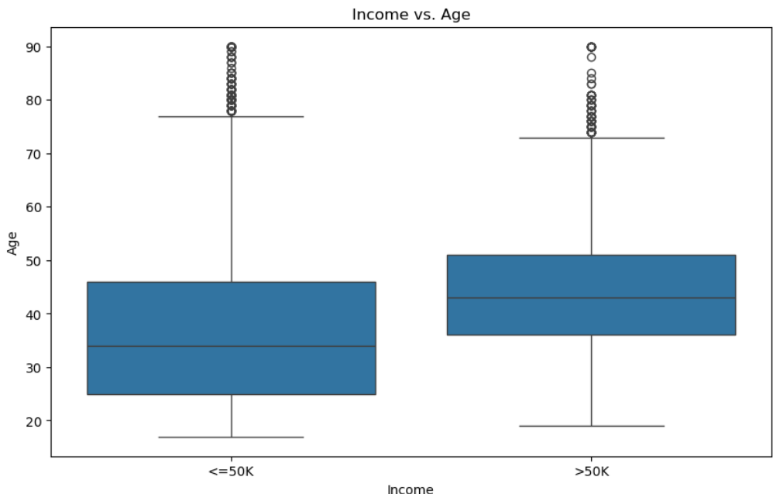
EDA’s
Income vs. Hours per Week:​
The box plots compare the distribution of hours worked per week for individuals earning <=50K and those earning >50K.​
Income vs. Age:​
The box plots show the age distribution for individuals earning <=50K and those earning >50K.​
Income Distribution by Gender:
Overview: The bar chart shows the distribution of income categories (<=50K and >50K) across genders.
Notes:
Income Distribution by Gender: A significantly higher number of males earn more than $50K compared to females.Most individuals in both genders earn <=50K, with males having a larger count in both income categories.
Income vs. Hours per Week: The median hours per week is slightly higher for individuals earning >50K.There is a wider range of hours worked among those earning <=50K, with more outliers indicating variability in working hours. Income vs. Age: Individuals earning >50K are generally older, with a higher median age compared to those earning <=50K.
The age range for both income categories is similar, but there are more younger individuals (in their 20s and 30s) in the <=50K category.
Outliers in the age distribution are present in both income categories, indicating that some older individuals still earn <=50K and some younger individuals earn >50K.

Slide 8
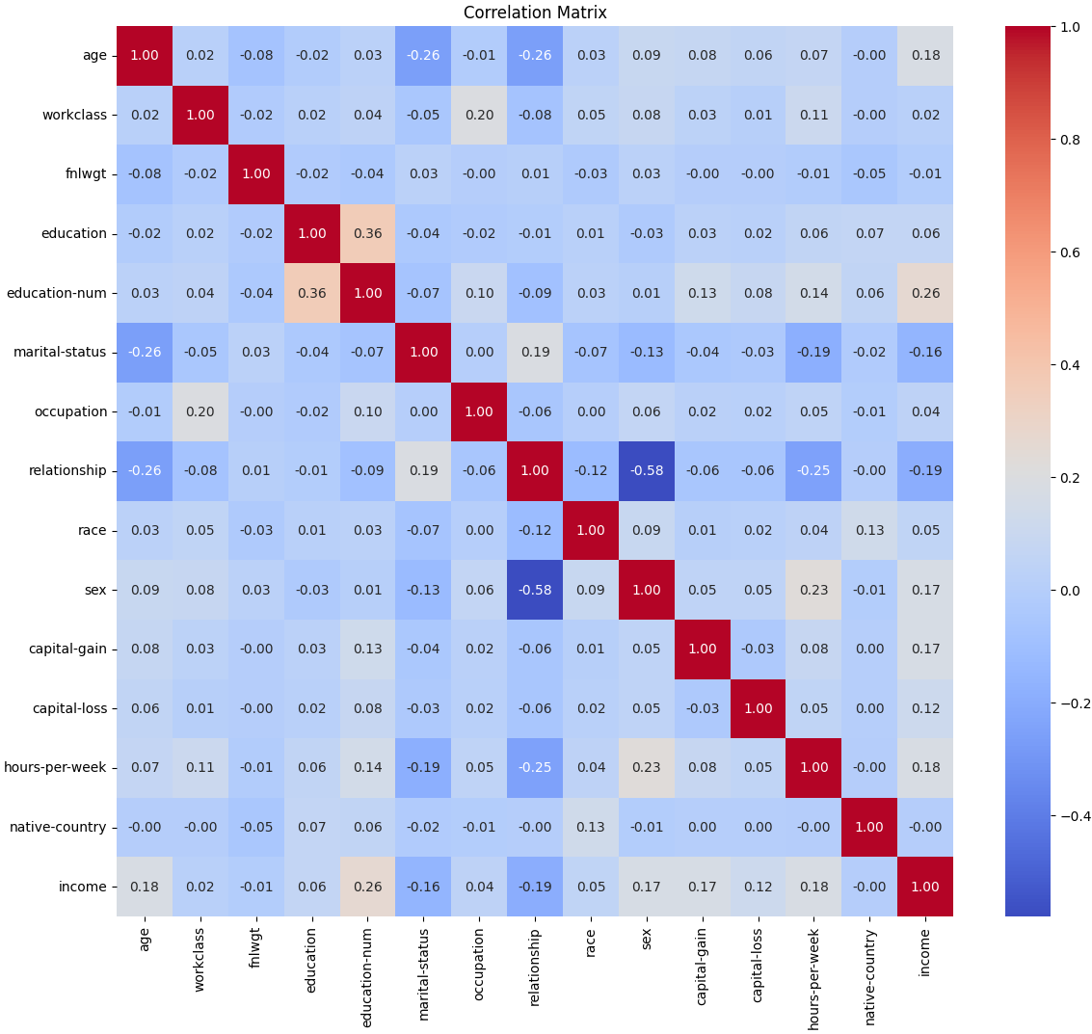
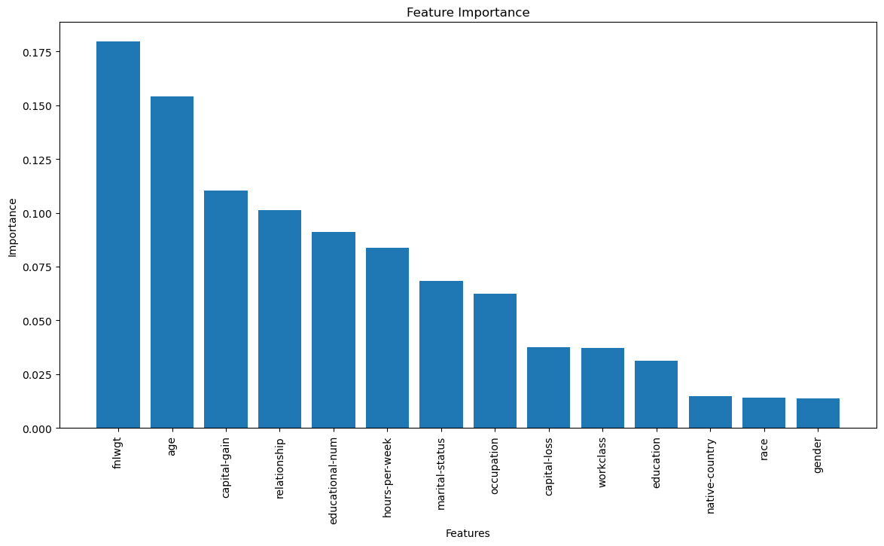
Feature Selection and Dimensionality Reduction

Slide 9
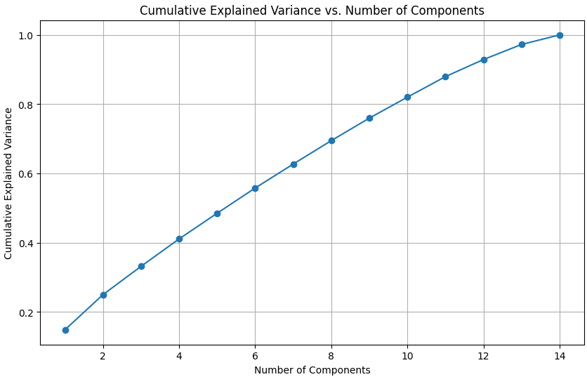
Feature Selection and Dimensionality Reduction
Elbow method
No Inflection Point
12 PCA's to exceed 95% explained variance
No dimensionality reduction performed

Slide 10
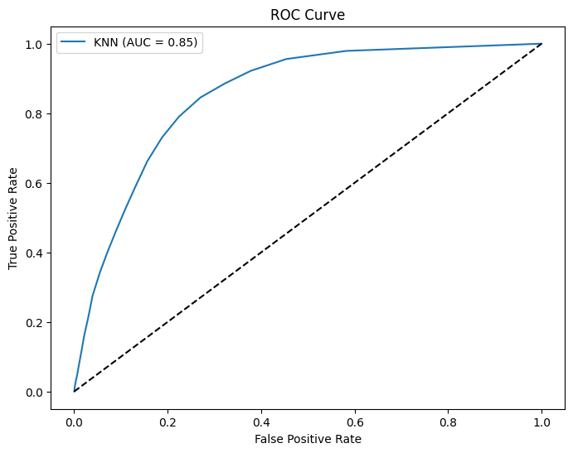
K-Nearest Neighbours Optimization
K-Nearest Neighbours
Accuracy 0.8527
K-Nearest Neighbours
N neighbors = 27
Weights = uniform
All points in each neighborhood are weighted equally
Metric = Manhattan
Grid-based system for Distance
Manhattan Distance(x, y)= ∑∣xi −y∣
Confusion Matrix
 | Actual Positive | Actual Negative
Predicted Positive | 7907 | 323
Predicted Negative | 1116 | 423

Slide 11
Model Assumptions
K-nearest neighbors
Accuracy: 0.8527
Feature Similarity
KNN assumes that similar data points are close to each other in the feature space.
Distance metrics are used to determine 'nearness'
Scaling
assumes that all features contribute equally to the distance metric
Non-Linearity
KNN does not assume a linear relationship between input features and the target variable
Large Data
Non-parametric
Does not make assumptions about the underlying assumption of the data

Slide 12
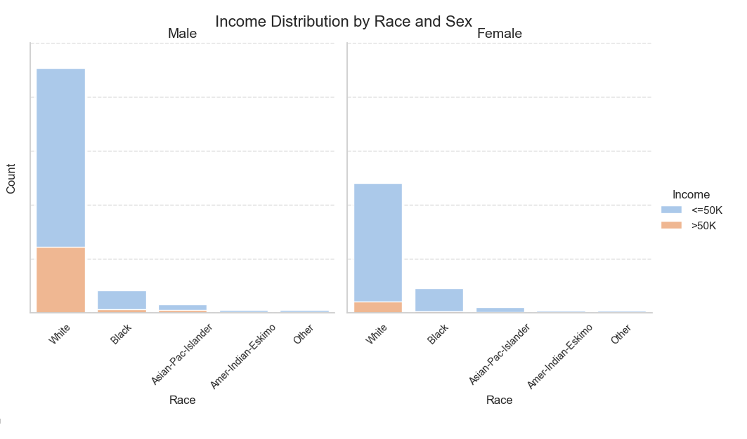
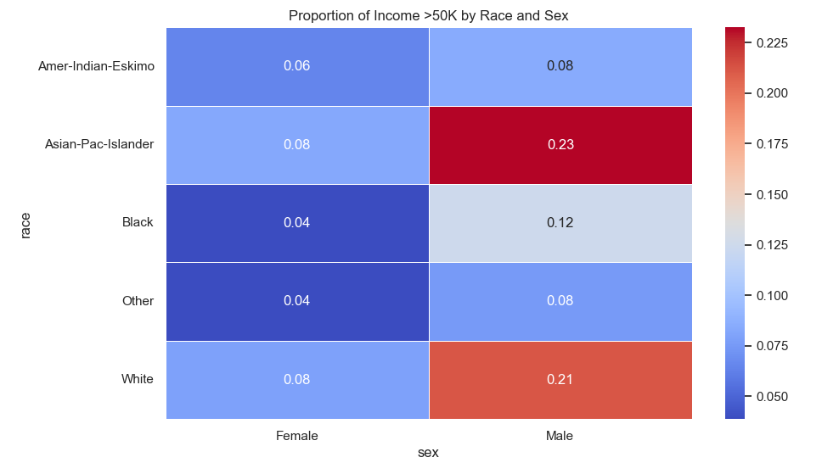
Are there significant differences in income levels based on demographic factors, how can these be quantified

Slide 13
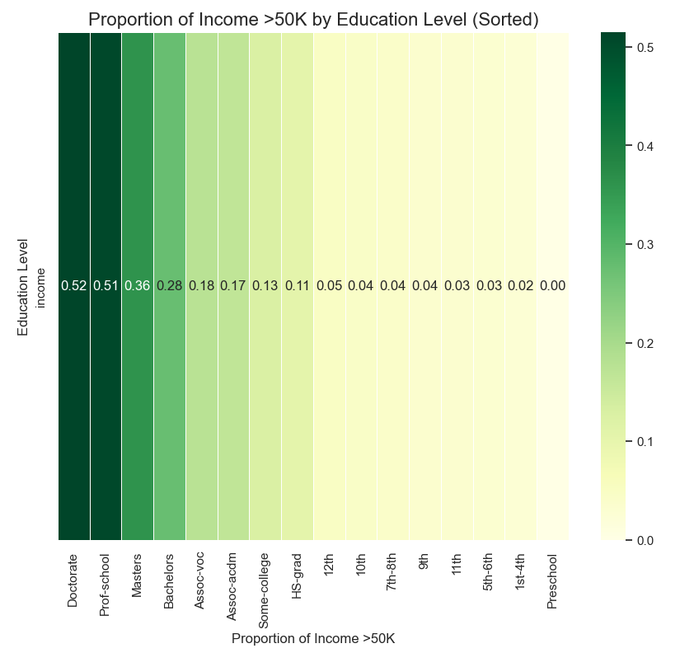
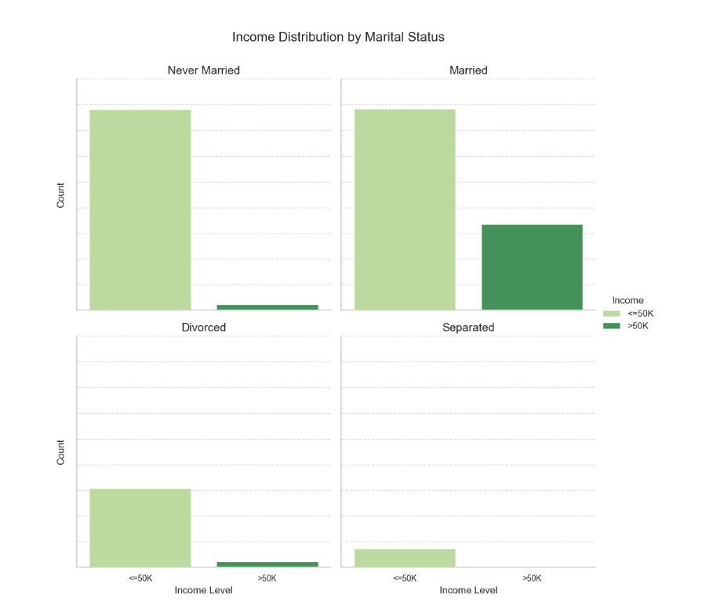
Which controllable variables can increase a person' s income?

Slide 14
Conclusion
Key Insights:
Demographic Analysis:
The analysis revealed that income levels are influenced by factors such as education level, gender, occupations, and more.
Modeling Outcomes:
The K-Nearest Neighbors model achieved an accuracy of 85.27%, effectively classifying income levels.
Project Milestones:
Data Preprocessing: Addressed missing values and encoded categorical variables.
Exploratory Data Analysis: Uncovered patterns and distributions related to income levels.
Feature Selection: Applied PCA but retained all features due to the lack of a clear inflection point.
Modeling: Optimized the KNN model with Manhattan distance and uniform weights.

Slide 15
Future Work
Advanced Feature Engineering:
Create New Features: Explore additional feature engineering techniques to uncover new variables that may enhance model accuracy and interpretability.
Address Potential Bias: Investigate and mitigate any biases introduced by demographic factors, such as gender and race, to ensure a fair and unbiased model.
Deployment Considerations:
Model Deployment: Plan for deployment strategies in real-world applications, including setting up monitoring systems to ensure the model remains accurate over time.
User Feedback Integration: Implement a feedback loop to continually improve the model based on user interactions and outcomes.
Notes:
Hello

Slide 16
REFRENCES
Becker, Barry, and Ronny Kohavi. “UCI Machine Learning Repository.” Archive.ics.uci.edu, 30 Apr. 1996,https://archive.ics.uci.edu/dataset/2/adult
Commons — Attribution 4.0 International — CC by 4.0.” Creativecommons.org, 2018, https://creativecommons.org/licenses/by/4.0/legalcode

Slide 17
Thank you

